Slide 1
DNS – Domain Name Service

Slide 2
What is Domain Name ?
Familiar, easy to remember names for computers on the Internet (such as sliate.net).
alphanumeric names for IP addresses( e.g., www.google.com, ietf.org)
Correspond to a series of numbers (called Internet Protocol numbers, IP addresses) that serve as routing addresses on the Internet.
Domain names are used generally as a convenient way of locating information and reaching others on the Internet.

Slide 3
What is DNS?
Domain Name Service/Domain Name System
Is an Internet-wide distributed database that translates between domain names and IP addresses
Defines a hierarchical namespace where each level of the namespace is separated by a “.”
Provides resolution of names to IP addresses and resolution of IP addresses to names

Slide 4
What does it mean to “register” a Domain Name
The Internet domain name system (DNS) consists of a directory, organized hierarchically, of all the domain names and their corresponding computers registered to particular companies and persons using the Internet.
When you register a domain name, it will be associated with the computer on the Internet you designate during the period the registration is in effect.

Slide 5
What is a DNS Server?
Computer running DNS service
Can be:
Microsoft® Windows® .NET Server 2003
Windows 2000
Microsoft Windows® NT 4
UNIX
Linux
NetWare
Etc.
Capabilities vary by operating system and/or DNS server software version

Slide 6
What is DNS Resolution?
DNS Resolution is the procedure used to resolve a IP address from a domain name.
This is very similar to how we get the phone number of a person we want to contact.
It is all based on hierarchy.

Slide 7
DNS Resolution analogy
Looking up a phone number
Get the phone book of the right city
People are listed by last name
Then narrow it down to a first name.
It is the phone number that allows you to communicate over the phone, not the person’s name.

Slide 8
DNS Foundation
All computers communicate by addressing each other using IP addresses.
So every time you try to connect to a website, or send an e-mail, DNS resolution is occurring.
Just like phone numbers, multiple domain names can resolve to the same IP address. (just like multiple people can have the same phone number).

Slide 9
Before there was DNS ….
…. there was the HOSTS.TXT file
Before DNS (until 1985), the name-to-IP address was done by downloading a single file (hosts.txt) from a central server with FTP.
Names in hosts.txt are not structured.
The hosts.txt file still works on most operating systems. It can be used to define local names.

Slide 10
Domain Names vs. URLs
A domain name is contained in a URL. See the examples below.
ftp://ftp.company.com/downloads.report.doc
http://www.networkclue.com/index.php
Protocol
Hostname/name of the server
Domain Name
Resource or File
Fully Qualified Domain Name (FQDN)

Slide 11
Resolver and name server
An application program on a host accesses the domain system through a DNS client, called the resolver
Resolver contacts DNS server, called name server
DNS server returns IP address to resolver which passes the IP address to application
Reverse lookups are also possible, i.e., find the hostname given an IP address

Slide 12
Resolver
Computer that requests DNS resolution
Issues queries that ask for specific types of mappings of computers and IP addresses (records)
Query types determine behavior of DNS server receiving query
Lookup types determine whether a name-to-IP mapping or an IP-to-name mapping is sought

Slide 13
Query and Lookup Types
Query Types
Iterative query | The DNS server returns an answer to the query or a pointer to other DNS servers
Recursive query | The DNS server returns a complete answer to the query, not a pointer to another DNS server
Lookup Types
Forward lookup | Requests name-to-address resolution
Reverse lookup | Requests address-to-name resolution

Slide 14

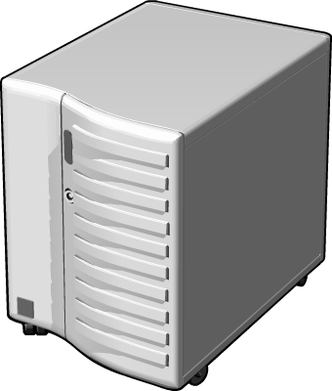


DNS Zone Types: Forward and Reverse Lookup
Forward Lookup
IP address for zoom.com?
IP address = 192.168.1.50
DNS Server
Reverse Lookup
Name for 192.168.1.50?
Name = zoom.com
DNS Server

Slide 15
Design principle of DNS
The naming system on which DNS is based is a hierarchical and logical tree structure called the domain namespace.
An organization obtains authority for parts of the name space, and can add additional layers of the hierarchy
Names of hosts can be assigned without regard of location on a link layer network, IP network or autonomous system
In practice, allocation of the domain names generally follows the allocation of IP address, e.g.,
All hosts with network prefix 128.143/16 have domain name suffix virginia.edu
All hosts on network 128.143.136/24 are in the Computer Science Department of the University of Virginia

Slide 16
DNS Name hierarchy
DNS hierarchy can be represented by a tree
Root and top-level domains are administered by an Internet central name registration authority (ICANN)
Below top-level domain, administration of name space is delegated to organizations
Each organization can delegate further
Managed by UofT
Managed by ECE Dept.

Slide 17
Domain name system
Each node in the DNS tree represents a DNS name
Each branch below a node is a DNS domain.
DNS domain can contain hosts or other domains (subdomains)
Example: DNS domains are ., edu, virginia.edu, cs.virginia.edu

Slide 18
Domain names
Hosts and DNS domains are named based on their position in the domain tree
Every node in the DNS domain tree can be identified by a unique Fully Qualified Domain Name (FQDN). The FQDN gives the position in the DNS tree.
A FQDN consists of labels (“cs”,“virginia”,”edu”) separated by a period (“.”)
There can be a period (“.”) at the end.
Each label can be up to 63 characters long
FQDN contains characters, numerals, and dash character (“-”)
FQDNs are not case-sensitive

Slide 19
Top-level domains
Three types of top-level domains:
Organizational: 3-character code indicates the function of the organization
Used primarily within the US
Examples: gov, mil, edu, org, com, net
Geographical: 2-character country or region code
Examples: us, va, jp, de,lk,uk
Reverse domains: A special domain (in-addr.arpa) used for IP address-to-name mapping
There are more than 200 top-level domains.

Slide 20
Organizational top-level domains
com | Commercial organizations
edu | Educational institutions
gov | Government institutions
int | International organizations
mil | U.S. military institutions
net | Networking organizations
org | Non-profit organizations

Slide 21
The Current TLDs

Slide 22
Hierarchy of name servers
The resolution of the hierarchical name space is done by a hierarchy of name servers
Each server is responsible (authoritative) for a contiguous portion of the DNS namespace, called a zone.
Zone is a part of the subtree
DNS server answers queries about hosts in its zone

Slide 23
Authority and delegation
Authority for the root domain is with the Internet Corporation for Assigned Numbers and Names (ICANN)
ICANN delegates to accredited registrars (for gTLDs) and countries for country code top level domains (ccTLDs)
Authority can be delegated further
Chain of delegation can be obtained by reading domain name from right to left.
Unit of delegation is a “zone”.

Slide 24
DNS domain and zones
Each zone is anchored at a specific domain node, but zones are not domains.
A DNS domain is a branch of the namespace
A zone is a portion of the DNS namespace generally stored in a file (It could consists of multiple nodes)
A server can divide part of its zone and delegate it to other servers

Slide 25
DNS Namespace
.
.org
.com
.edu
.au
unicef.org
msn.com
mtu.edu
msu.edu
gov.au
com.au
microsoft.com.
corp.microsoft.com.
corp.
microsoft.
com
.
Subdomain
Second-Level Domain
Top-Level Domain
Root

Slide 26
Primary and secondary name servers
For each zone, there must be a primary name server and a secondary name server
The primary server (master server) maintains a zone file which has information about the zone. Updates are made to the primary server
The secondary server copies data stored at the primary server.
Adding a host:
When a new host is added (“gold.cs.virginia.edu”) to a zone, the administrator adds the IP information on the host (IP address and name) to a configuration file on the primary server

Slide 27
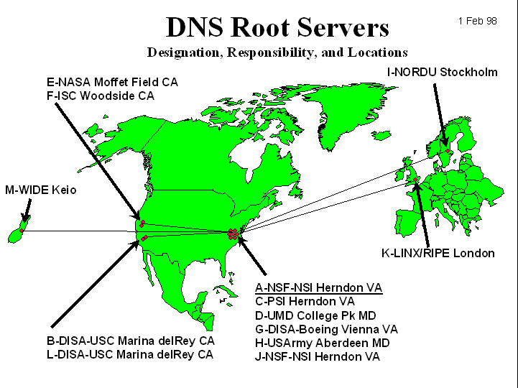
Root name servers
The root name servers know how to find the authoritative name servers for all top-level zones.
There are only 13 root name servers
Root servers are critical for the proper functioning of name resolution
Notes:
Nslookup
Tracert – see dns access

Slide 28
The Root Nameservers
Modification of the root zone file is pointless unless that zone file is published
The root zone file is published on 13 servers, “A” through “M”, around the Internet
Root name server operations currently provided by volunteer efforts by a very diverse set of organizations

Slide 29
Root Name Server Operators
Nameserver | Operated by: | IP Address
A | Verisign (US East Coast) | 198.41.0.4
B | University of S. California –Information Sciences Institute (US West Coast) | 128.9.0.107
C | PSI (US East Coast) | 192.33.4.12
D | University of Maryland (US East Coast) | 128.8.10.90
E | NASA (Ames) (US West Coast) | 192.203.23
F | Internet Software Consortium (US West Coast) | 192.5.5.241
G | U. S. Dept. of Defense (ARL) (US East Coast) | 192.112.36.4
H | U. S. Dept. of Defense (DISA) (US East Coast) | 128.63.2.53
I | KTH (SE) | 192.36.148.17
J | Verisign (US East Coast) | 198.41.0.10
K | RIPE-NCC (UK) | 193.0.14.129
L | ICANN (US West Coast) | 198.32.64
M | WIDE (JP) | 202.12.27.33

Slide 30
Domain name resolution
User program issues a request for the IP address of a hostname
Local resolver formulates a DNS query to the name server of the host
Name server checks if it is authorized to answer the query.
If yes, it responds.
Otherwise, it will query other name servers, starting at the root tree
When the name server has the answer it sends it to the resolver.

Slide 31
Recursive and Iterative Queries
There are two types of queries:
Recursive queries
Iterative (non-recursive) queries
The type of query is determined by a bit in the DNS query
Recursive query: When the name server of a host cannot resolve a query, the server issues a query to resolve the query
Iterative queries: When the name server of a host cannot resolve a query, it sends a referral to another server to the resolver

Slide 32
Recursive Queries
A query made from a client to a DNS server in which the server assumes the full workload
DNS server returns either a complete answer or negative
Issued by:
Client computers
DNS servers configured to use forwarder(s)

Slide 33
Recursive Queries
In a recursive query, the resolver expects the response from the name server
If the server cannot supply the answer, it will send the query to the “closest known” authoritative name server (here: In the worst case, the closest known server is the root server)
The root sever sends a referral to the “edu” server. Querying this server yields a referral to the server of “virginia.edu”
… and so on

Slide 34
Iterative Queries
Receiving server may return an answer, a negative response, or a referral to other DNS server(s)
Typically issued by DNS servers not configured to use forwarders for resolution of queries
“Walk” the DNS tree
“Give me an answer or refer me to somebody else who can help me obtain resolution.”

Slide 35
Iterative Queries
In an iterative query, the name server sends a closest known authoritative name server a referral to the root server.
This involves more work for the resolver

Slide 36
Caching
To reduce DNS traffic, name servers caches information on domain name/IP address mappings
When an entry for a query is in the cache, the server does not contact other servers
Note: If an entry is sent from a cache, the reply from the server is marked as “unauthoritative”

Slide 37




How DNS Works
Root Hints:
Is name in cache?
Am I authoritative?
Iterative Query: server1.microsoft.com.
To: Root Servers
b.root-servers.net [128.9.0.107]
j.root-servers.net [198.41.0.10]
k.root-servers.net [193.0.14.129]
l.root-servers.net [198.32.64.12]
m.root-servers.net [202.12.27.33]
i.root-servers.net [192.36.148.17]
e.root-servers.net [192.203.230.10]
d.root-servers.net [128.8.10.90]
a.root-servers.net [198.41.0.4]
h.root-servers.net [128.63.2.53]
c.root-servers.net [192.33.4.12]
g.root-servers.net [192.112.36.4]
f.root-servers.net [192.5.5.241]
No
10.1.1.1
No
Root Server
10.1.1.1
I don’t know. Ask:
Root Server
Am I authoritative?
Delegation:
.com. =
Is name in cache?
Iterative Query: server1.microsoft.com.
To: TLD Servers
No
a.gtld-servers.net [192.5.6.30]
g-gtld-servers.net [192.42.93.30]
c.gtld-servers.net [192.26.92.30]
i.gtld-servers.net [192.36.144.133]
b.gtld-servers.net [203.181.106.5]
d.gtld-servers.net [192.31.80.30]
l.gtld-servers.net [192.41.162.30]
f.gtld-servers.net [192.35.51.30]
j.gtld-servers.net [210.132.100.101]
k.gtld-servers.net [213.177.194.5]
e.gtld-servers.net [192.12.94.30]
m.gtld-servers.net [202.153.114.101]
Cache response
Iterative Query: server1.microsoft.com.
To: microsoft.com DNS servers
a.gtld-servers.net [192.5.6.30]
g-gtld-servers.net [192.42.93.30]
c.gtld-servers.net [192.26.92.30]
i.gtld-servers.net [192.36.144.133]
b.gtld-servers.net [203.181.106.5]
d.gtld-servers.net [192.31.80.30]
l.gtld-servers.net [192.41.162.30]
f.gtld-servers.net [192.35.51.30]
j.gtld-servers.net [210.132.100.101]
k.gtld-servers.net [213.177.194.5]
e.gtld-servers.net [192.12.94.30]
m.gtld-servers.net [202.153.114.101]
I don’t know. Ask:
Am I authoritative?
Delegation:
microsoft.com. =
Is name in cache?
server1.microsoft.com=192.168.7.99
TLD Server
dns2.cp.msft.net [207.46.138.21]
dns1.cp.msft.net [207.46.138.20]
dns1.tk.msft.net [207.46.232.37]
dns2.tk.msft.net [207.46.232.38]
dns3.uk.msft.net [213.199.144.151]
dns4.uk.msft.net [213.199.144.152]
dns3.jp.msft.net [207.46.72.123]
dns4.jp.msft.net [207.46.72.124]
dns1.dc.msft.net [207.68.128.151]
dns2.dc.msft.net [207.68.128.152]
dns1.sj.msft.net [207.46.97.11]
No
TLD Server
server1.microsoft.com=192.168.7.99
server1.microsoft.com=192.168.7.99
Recursive Query: server1.microsoft.com.
dns2.cp.msft.net [207.46.138.21]
dns1.cp.msft.net [207.46.138.20]
dns1.tk.msft.net [207.46.232.37]
dns2.tk.msft.net [207.46.232.38]
dns3.uk.msft.net [213.199.144.151]
dns4.uk.msft.net [213.199.144.152]
dns3.jp.msft.net [207.46.72.123]
dns4.jp.msft.net [207.46.72.124]
dns1.dc.msft.net [207.68.128.151]
dns2.dc.msft.net [207.68.128.152]
dns1.sj.msft.net [207.46.97.11]
Is name in cache?
Recursive Query: server1.microsoft.com.
Am I authoritative?
microsoft.com DNS Servers
microsoft.com DNS Servers
No
Cache response
Yes
Preferred DNS Server: 10.1.1.1
http/tcp session- 192.168.7.99
http/tcp session- 192.168.7.99
192.168.7.99
192.168.7.99
http://server1.microsoft.com
http://server1.microsoft.com

